Slide 1
QR Decomposition

Slide 2
QR Decomposition using Householder Transformation
We calculate the Q,R factors of a Matrix using Householder Matrices.
We need to construct Householder matrices and iteratively multiply them in an order to generate QR.

Slide 3
Householder Matrices
The first step is to create the vector x, which is the k-th column of the matrix A, for step k. We define α=−sgn(xk).
Given the first column vector of the identity matrix, I of equal size to A, e1=(1,0,...,0)T, we create the vector u: u=x+αe1.
Once we have the vector u, we need to convert it to a unit vector, which we denote as v:v=u/||u||
Now we form the matrix Q out of the identity matrix I and the vector multiplication of v:Q=I−2vvT

Slide 4
Continued ..
Q is now an m×m Householder matrix, with Qx=(α,0,...,0)T. We will use Q to transform A to upper triangular form, giving us the matrix R. We denote Q as Qk and, since k=1 in this first step, we have Q1 as our first Householder matrix. We multiply this with A to give us:
The whole process is now repeated for the minor matrix A′, which will give a second Householder matrix Q′2. Now we have to "pad out" this minor matrix with elements from the identity matrix such that we can consistently multiply the Householder matrices together. Hence, we define Qk as the block matrix:

Slide 5
Continued ..
Once we have carried out t iterations of this process we have R as an upper triangular matrix: R=Q_{t}...Q₂Q₁A
Q is then fully defined as the multiplication of the transposes of each Qk: Q=Q^{T}₁Q^{T}₂...Q^{T}_{t}
Thus we get The QR factorization of A.

Slide 6
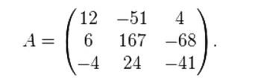
Example
Let us calculate the decomposition of

Slide 7
First, we need to find a reflection that transforms the first column of matrix A, vector a₁ = (12,6,-4)^{T} , to ||a₁||e₁ = (14,0,0)^{T}
Now, u = x + αe1, and v = u / ||u||,
Here a = -14 and x = a1 = (12,6,-4)^{T}
Therefore

Slide 8
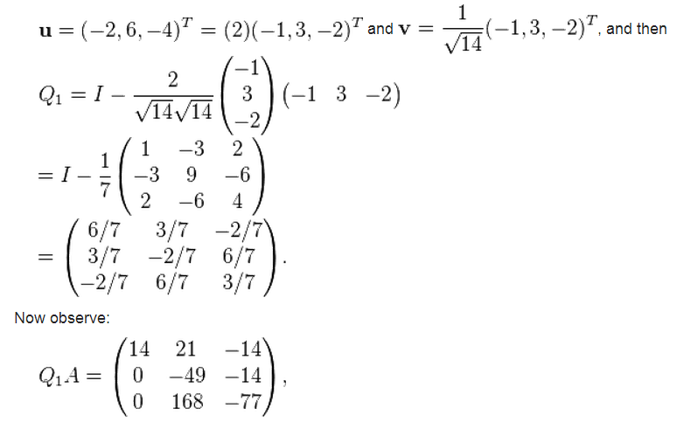

Slide 9

so we already have almost a triangular matrix. We only need to zero the (3, 2) entry.
Take the (1, 1) minor, and then apply the process again to

Slide 10
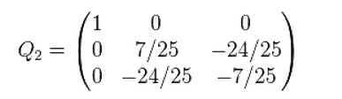
By the same method as above, we obtain the matrix of the Householder transformation

Slide 11
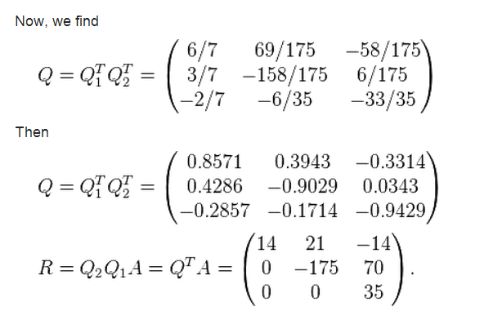
Thus we have our Q and R where Q is orthogonal and R is upper triangular.

